Slide 1
Rutter Lab Isolation Bootcamp
#1: Introduction to the command line
Slides with “ARQ” are copied or adapted from Aaron R. Quinlan

Slide 2
Access the slides and files here:
https://github.com/j-berg/rutter_lab_coding_bootcamp

Slide 3
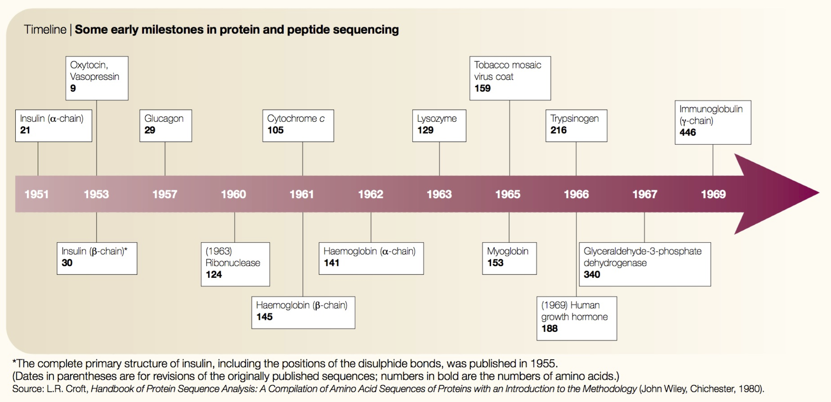
Comp. biology was born in the 1960s
ARQ
Expanding collection of amino acid sequences in the 1960s
Need for computational power to answer questions and study protein biology
Scarcity of academic computers was no longer a major problem
Joel Hagen, “The origins of bioinformatics”, NRG, Dec. 2000

Slide 4

What is Unix?
ARQ
Definition 1: Unix is not an acronym; it is a pun on "Multics". Multics was a large multi-user operating system that was being developed at Bell Labs shortly before Unix was created in the early '70s. Brian Kernighan is credited with the name.
Definition 2: Where computational genomics is done.
Definition 3: Your dear friend.
Recommended reading: “The Evolution of the Unix Time-sharing system”, Dennis M. Ritchie https://pdfs.semanticscholar.org/f64f/6e66da16e93ebf4221fc8915b2420fd56b66.pdf

Slide 5
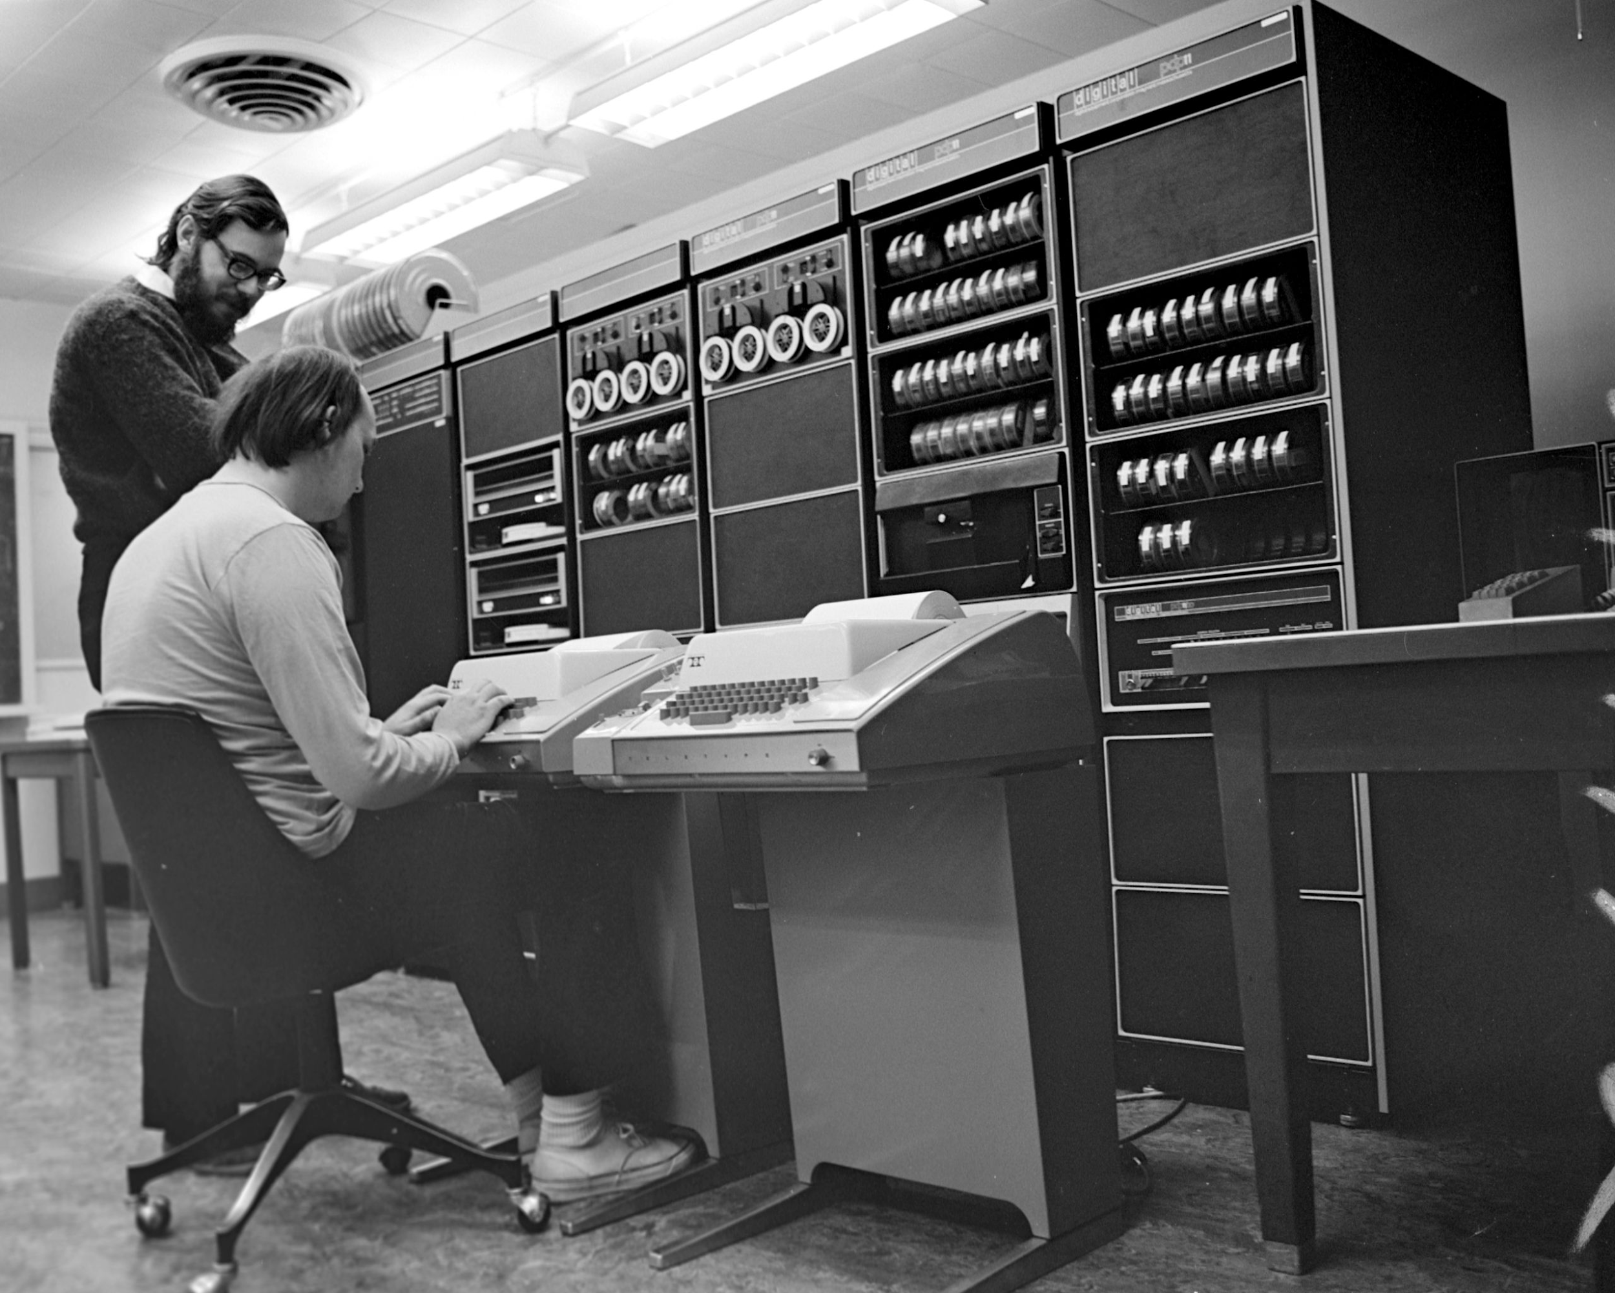
Unix history
ARQ
Ken Thompson (sitting) and Dennis Ritchie working together at a PDP-11
Initial file system, command interpreter (shell), and process management started by Ken Thompson
Device files and further development from Dennis Ritchie, as well as McIlroy and Ossanna (to a lesser degree)
Vast array of simple, dependable tools that each do one simple task.
By combining these tools, one can conduct rather sophisticated analyses
Wildly popular platform for high performance computing. Supports parallelism.
SunOS/Solaris, IBM's AIX, Hewlett-Packard HP-UX, OSX, Linux, Android, etc.
Credit:https://en.wikipedia.org/wiki/History_of_Unix

Slide 6
Unix basics
ARQ

Slide 7
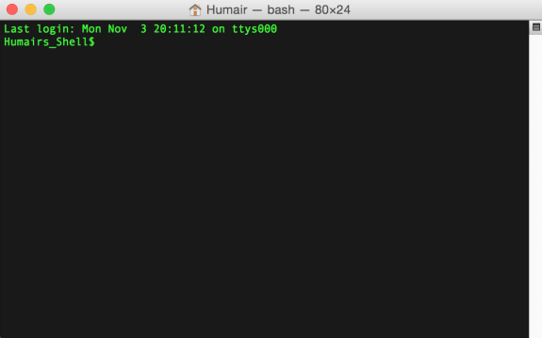
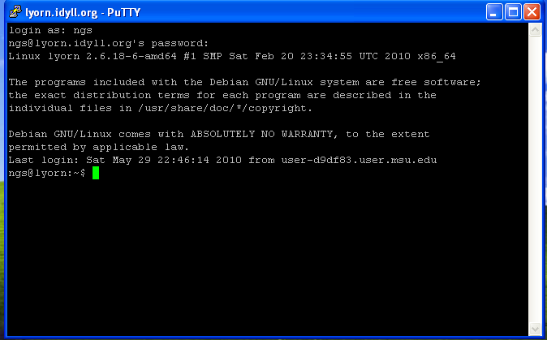
Connecting to a Unix computer via the terminal
ARQ
“Terminal” in OSX
“putty” for Windows

Slide 8
The “prompt”
ARQ
The prompt is just a patient little thing that waits around for you to tell it what to do via “commands”.
Command syntax must be exact. In this way, Unix is dumb. It cannot infer what you meant if you misspell, provide the wrong syntax, etc.

Slide 9

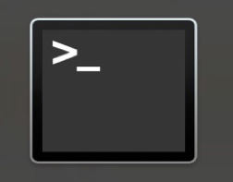
Launching OSX “Terminal”
ARQ
Applications
Utilities
Terminal

Slide 10
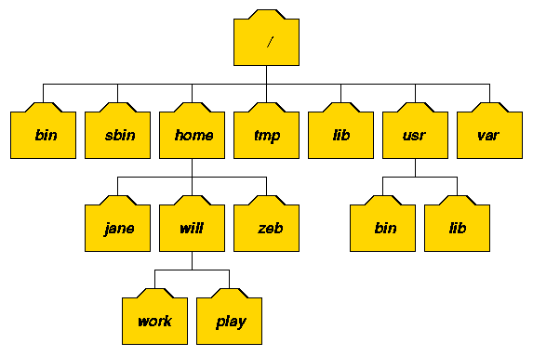
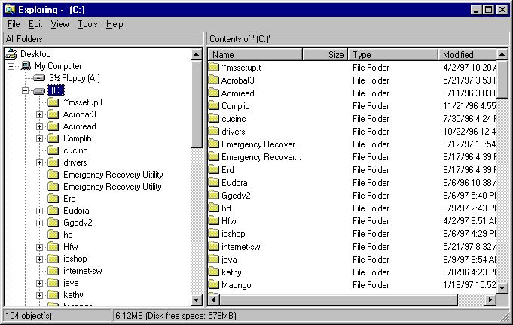
The Unix file system. A tree just like OSX and Windows
ARQ

Slide 11
I am lazy. You should be too. Shortcuts!!!
Go back to past commands with the arrow keys.
The history command will report the commands you have used in the past.
Type the "Ctrl" "r" keys at the same time to bring up a search for commands that contain search terms. Use the arrow keys to cycle through all commands that match the search term.
Use the "Tab" key for autocomplete - just like your smartphone!
Type the "Ctrl" "c" keys at the same time to kill a command.
ARQ

Slide 12

The ls command (list files and directories)
(What files and directories can be found in the current directory?)
ARQ
Image we are user “luke”
Luke’s home directory
root
list luke’s home directory
$ ls
hi.txt proj1
home
bin
vol
command
result to standard
output (stdout)
luke
leia
ls
head
cat
hi.txt
proj1
Example Unix file system (a “tree”)
data1.txt
data2.txt

Slide 13
The ls command (list files and directories)
(What files and directories can be found in the current directory?)
ARQ
Example Unix file system (a “tree”)
Image we are user “luke”
Luke’s home directory
root
list luke’s home directory
$ ls
hi.txt proj1
list luke’s home directory
$ ls ~
hi.txt proj1
home
bin
vol
luke
leia
ls
head
cat
hi.txt
proj1
data1.txt
data2.txt

Slide 14
The cd command (change directories)
(cd helps to navigate through the Unix directory tree)
ARQ
Example Unix file system (a “tree”)
Image we are user “luke”
list luke’s home directory
$ ls
hi.txt proj1
root
move to luke’s “proj1” directory
$ cd proj1
list luke’s “proj1” directory
home
bin
vol
$ ls
data1.txt data2.txt
Move “up” the tree to luke’s home directory
$ cd ..
$ ls
hi.txt proj1
luke
leia
ls
head
cat
Move “up” the tree to the “usr” directory
$ cd ..
$ ls
luke leia
hi.txt
proj1
$ cd luke/proj1
Move directly to luke’s “proj1” directory
data1.txt
data2.txt
$ cd /bin
Move to the system “bin” directory

Slide 15
The pwd command (present working directory)
(Where am I? That is, in which directory am I?)
ARQ
Imagine we are user “luke”
Example Unix file system (a “tree”)
root
Where am I?
$ pwd
/home/luke
move to luke’s “proj1” directory
$ cd proj1
home
bin
vol
Where am I?
$ pwd
/home/luke/proj1
luke
leia
ls
head
cat
move back to luke’s home directory
$ cd ..
Where am I?
$ pwd
/home/luke
hi.txt
proj1
data1.txt
data2.txt

Slide 16
The mkdir command (make a new directory)
ARQ
Example Unix file system (a “tree”)
Image we are user “luke”
root
Where am I?
$ pwd
/usr/luke
List luke’s home directory
$ ls
Hi.txt proj1
home
bin
vol
Move to the “proj1” directory
$ cd proj1
luke
leia
ls
head
cat
$ mkdir data
Make a new “data” directory in proj1
hi.txt
proj1
data1.txt
data2.txt
data

Slide 17
The touch command (create an empty file)
ARQ
Example Unix file system (a “tree”)
Image we are user “luke”
root
Where am I?
$ pwd
/usr/luke
List luke’s home directory
$ ls
Hi.txt proj1
home
bin
vol
$ cd proj1/data
Move to the “proj1/data” directory
luke
leia
ls
head
cat
Create an empty text file called “frost.txt”
$ touch frost.txt
hi.txt
proj1
data1.txt
data2.txt
data
frost.txt

Slide 18
The head command
(peak at the first n lines in an input file or stream)
ARQ
The contents of frost.txt
$ head -n 5 frost.txt
Whose woods these are I think I know.
His house is in the village though;
He will not see me stopping here
To watch his woods fill up with snow.
My little horse must think it queer
To stop without a farmhouse near
Between the woods and frozen lake
The darkest evening of the year.
He gives his harness bells a shake
To ask if there is some mistake.
The only other sound’s the sweep
Of easy wind and downy flake.
The woods are lovely, dark and deep,
But I have promises to keep,
And miles to go before I sleep,
And miles to go before I sleep.
Whose woods these are I think I know.
His house is in the village though;
He will not see me stopping here
To watch his woods fill up with snow.
My little horse must think it queer
$ head -n 10 frost.txt
Whose woods these are I think I know.
His house is in the village though;
He will not see me stopping here
To watch his woods fill up with snow.
My little horse must think it queer
To stop without a farmhouse near
Between the woods and frozen lake
The darkest evening of the year.
He gives his harness bells a shake
To ask if there is some mistake.

Slide 19
The head command
(peak at the first n lines in an input file or stream)
ARQ
-n is an argument or parameter to the head command that modulates its behavior. In this case to report the first 5 lines instead of the first 10, which is the default behavior
The contents of frost.txt
$ head -n 5 frost.txt
Whose woods these are I think I know.
His house is in the village though;
He will not see me stopping here
To watch his woods fill up with snow.
My little horse must think it queer
To stop without a farmhouse near
Between the woods and frozen lake
The darkest evening of the year.
He gives his harness bells a shake
To ask if there is some mistake.
The only other sound’s the sweep
Of easy wind and downy flake.
The woods are lovely, dark and deep,
But I have promises to keep,
And miles to go before I sleep,
And miles to go before I sleep.
Whose woods these are I think I know.
His house is in the village though;
He will not see me stopping here
To watch his woods fill up with snow.
My little horse must think it queer
\n
\n
\n
\n
\n
\n
\n
\n
\n
\n
\n
\n
\n
\n
\n
\n
$ head -n 10 frost.txt
Whose woods these are I think I know.
His house is in the village though;
He will not see me stopping here
To watch his woods fill up with snow.
My little horse must think it queer
To stop without a farmhouse near
Between the woods and frozen lake
The darkest evening of the year.
He gives his harness bells a shake
To ask if there is some mistake.
Important!
Each line ends with a special, hidden character called the newline (\n) character.
This is how “head” knows where the lines start and end.
Notes:
Go over special characters

Slide 20
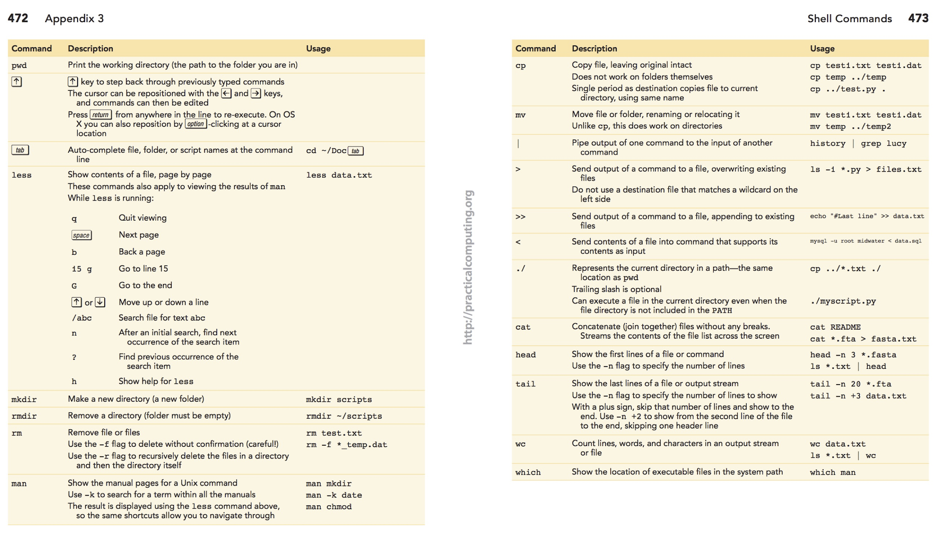
Unix reference “cheat sheet”: (print/mark the link below!)
ARQ
http://practicalcomputing.org/files/PCfB_Appendices.pdf

Slide 21
Important reminders
Spaces matter!
Capitalization matters!
The computer is a dumb robot that needs very specific instructions to do anything correctly
https://en.wikipedia.org/wiki/Bender_(Futurama)#/media/File:Bender_Rodriguez.png

Slide 22
Convention: The "$" at the beginning of each command represents the shell prompt. Don't copy/paste it.
ARQ
$ head -n 10 frost.txt

Slide 23
What do you think the tail command does?
ARQ

Slide 24
The cat command
(report every line in an input file or stream)
ARQ
$ cat dna.fasta
>NC_012920.1 Homo sapiens mitochondrion, complete genome
GATCACAGGTCTATCACCCTATTAACCACTCACGGGAGCTCTCCATGCATTTGGTATTTTCGTCTGGGGG
GTATGCACGCGATAGCATTGCGAGACGCTGGAGCCGGAGCACCCTATGTCGCAGTATCTGTCTTTGATTC
CTGCCTCATCCTATTATTTATCGCACCTACGTTCAATATTACAGGCGAACATACTTACTAAAGTGTGTTA
ATTAATTAATGCTTGTAGGACATAATAATAACAATTGAATGTCTGCACAGCCACTTTCCACACAGACATC
ATAACAAAAAATTTCCACCAAACCCCCCCTCCCCCGCTTCTGGCCACAGCACTTAAACACATCTCTGCCA
AACCCCAAAAACAAAGAACCCTAACACCAGCCTAACCAGATTTCAAATTTTATCTTTTGGCGGTATGCAC
TTTTAACAGTCACCCCCCAACTAACACATTATTTTCCCCTCCCACTCCCATACTACTAATCTCATCAATA
CAACCCCCGCCCATCCTACCCAGCACACACACACCGCTGCTAACCCCATACCCCGAACCAACCAAACCCC
AAAGACACCCCCCACAGTTTATGTAGCTTACCTCCTCAAAGCAATACACTGAAAATGTTTAGACGGGCTC
ACATCACCCCATAAACAAATAGGTTTGGTCCTAGCCTTTCTATTAGCTCTTAGTAAGATTACACATGCAA
GCATCCCCGTTCCAGTGAGTTCACCCTCTAAATCACCACGATCAAAAGGAACAAGCATCAAGCACGCAGC
AATGCAGCTCAAAACGCTTAGCCTAGCCACACCCCCACGGGAAACAGCAGTGATTAACCTTTAGCAATAA
ACGAAAGTTTAACTAAGCTATACTAACCCCAGGGTTGGTCAATTTCGTGCCAGCCACCGCGGTCACACGA
TTAACCCAAGTCAATAGAAGCCGGCGTAAAGAGTGTTTTAGATCACCCCCTCCCCAATAAAGCTAAAACT

Slide 25
The cat command: add line numbers with -n
(report every line in an input file or stream)
ARQ
$ cat -n dna.fasta
1 >NC_012920.1 Homo sapiens mitochondrion, complete genome
2 GATCACAGGTCTATCACCCTATTAACCACTCACGGGAGCTCTCCATGCATTTGGTATTTTCGTCTGGGGG
3 GTATGCACGCGATAGCATTGCGAGACGCTGGAGCCGGAGCACCCTATGTCGCAGTATCTGTCTTTGATTC
4 CTGCCTCATCCTATTATTTATCGCACCTACGTTCAATATTACAGGCGAACATACTTACTAAAGTGTGTTA
5 ATTAATTAATGCTTGTAGGACATAATAATAACAATTGAATGTCTGCACAGCCACTTTCCACACAGACATC
6 ATAACAAAAAATTTCCACCAAACCCCCCCTCCCCCGCTTCTGGCCACAGCACTTAAACACATCTCTGCCA
7 AACCCCAAAAACAAAGAACCCTAACACCAGCCTAACCAGATTTCAAATTTTATCTTTTGGCGGTATGCAC
8 TTTTAACAGTCACCCCCCAACTAACACATTATTTTCCCCTCCCACTCCCATACTACTAATCTCATCAATA
9 CAACCCCCGCCCATCCTACCCAGCACACACACACCGCTGCTAACCCCATACCCCGAACCAACCAAACCCC
10 AAAGACACCCCCCACAGTTTATGTAGCTTACCTCCTCAAAGCAATACACTGAAAATGTTTAGACGGGCTC
11 ACATCACCCCATAAACAAATAGGTTTGGTCCTAGCCTTTCTATTAGCTCTTAGTAAGATTACACATGCAA
12 GCATCCCCGTTCCAGTGAGTTCACCCTCTAAATCACCACGATCAAAAGGAACAAGCATCAAGCACGCAGC
13 AATGCAGCTCAAAACGCTTAGCCTAGCCACACCCCCACGGGAAACAGCAGTGATTAACCTTTAGCAATAA
14 ACGAAAGTTTAACTAAGCTATACTAACCCCAGGGTTGGTCAATTTCGTGCCAGCCACCGCGGTCACACGA
15 TTAACCCAAGTCAATAGAAGCCGGCGTAAAGAGTGTTTTAGATCACCCCCTCCCCAATAAAGCTAAAACT

Slide 26
The wc command
(count the lines, words, and bytes in a file or stream)
ARQ
$ cat dna.fasta
How many lines words and bytes (characters) in dna.fasta?
$ wc dna.fasta
15 20 1051 dna.fasta
>NC_012920.1 Homo sapiens mitochondrion, complete genome
GATCACAGGTCTATCACCCTATTAACCACTCACGGGAGCTCTCCATGCATTTGGTATTTTCGTCTGGGGG
GTATGCACGCGATAGCATTGCGAGACGCTGGAGCCGGAGCACCCTATGTCGCAGTATCTGTCTTTGATTC
CTGCCTCATCCTATTATTTATCGCACCTACGTTCAATATTACAGGCGAACATACTTACTAAAGTGTGTTA
ATTAATTAATGCTTGTAGGACATAATAATAACAATTGAATGTCTGCACAGCCACTTTCCACACAGACATC
ATAACAAAAAATTTCCACCAAACCCCCCCTCCCCCGCTTCTGGCCACAGCACTTAAACACATCTCTGCCA
AACCCCAAAAACAAAGAACCCTAACACCAGCCTAACCAGATTTCAAATTTTATCTTTTGGCGGTATGCAC
TTTTAACAGTCACCCCCCAACTAACACATTATTTTCCCCTCCCACTCCCATACTACTAATCTCATCAATA
CAACCCCCGCCCATCCTACCCAGCACACACACACCGCTGCTAACCCCATACCCCGAACCAACCAAACCCC
AAAGACACCCCCCACAGTTTATGTAGCTTACCTCCTCAAAGCAATACACTGAAAATGTTTAGACGGGCTC
ACATCACCCCATAAACAAATAGGTTTGGTCCTAGCCTTTCTATTAGCTCTTAGTAAGATTACACATGCAA
GCATCCCCGTTCCAGTGAGTTCACCCTCTAAATCACCACGATCAAAAGGAACAAGCATCAAGCACGCAGC
AATGCAGCTCAAAACGCTTAGCCTAGCCACACCCCCACGGGAAACAGCAGTGATTAACCTTTAGCAATAA
ACGAAAGTTTAACTAAGCTATACTAACCCCAGGGTTGGTCAATTTCGTGCCAGCCACCGCGGTCACACGA
TTAACCCAAGTCAATAGAAGCCGGCGTAAAGAGTGTTTTAGATCACCCCCTCCCCAATAAAGCTAAAACT
How many lines (-l) in dna.fasta?
$ wc -l dna.fasta
16 dna.fasta
How many characters (-c) in dna.fasta?
$ wc -c dna.fasta
1051 dna.fasta
Think: Is this the same as the number of nucleotides in the sequence?

Slide 27
But what about doing
something useful?
ARQ

Slide 28
Let’s imagine you are a first year graduate student studying gene regulation in human muscle development.
You will need a list of genes and transcripts in the human genome.
I have placed such a file in a directory called “muscledev” within your “home” directory.
How would we get to the file, figure out what it is called, and see its contents?
ARQ
Notes:
To reproduce:
curl ftp://ftp.ensembl.org/pub/release-87/gtf/homo_sapiens/Homo_sapiens.GRCh38.87.gtf.gz > human.genes.gtf.gz gzip -d human.genes.gtf.gz; mv human.genes.gtf genes.gtf

Slide 29
Downloading a file
$ curl –O -L ftp://ftp.ensembl.org/pub/release-99/gtf/saccharomyces_cerevisiae/Saccharomyces_cerevisiae.R64-1-1.99.gtf.gz
$ gzip –d Saccharomyces_cerevisiae.R64-1-1.99.gtf.gz

Slide 30
The less command
(scroll through the contents of files page by page. less is “more” , because you can go forwards and backwards)
ARQ
#!genome-build GRCh38.p7
#!genome-version GRCh38
#!genome-date 2013-12
#!genome-build-accession NCBI:GCA_000001405.22
#!genebuild-last-updated 2016-06
1 havana gene 11869 14409 . + . gene_id "ENSG00000223972"; gene_version "5"; gene_name "DDX11L1"; gene_source "havana"; gene_biotype "transcribed_unprocessed_pseudogene"; havana_gene "OTTHUMG00000000961"; havana_gene_version "2";
1 havana transcript 11869 14409 . + . gene_id "ENSG00000223972"; gene_version "5"; transcript_id "ENST00000456328"; transcript_version "2"; gene_name "DDX11L1"; gene_source "havana"; gene_biotype "transcribed_unprocessed_pseudogene"; havana_gene "OTTHUMG00000000961"; havana_gene_version "2"; transcript_name "DDX11L1-002"; transcript_source "havana"; transcript_biotype "processed_transcript"; havana_transcript "OTTHUMT00000362751"; havana_transcript_version "1"; tag "basic"; transcript_support_level "1";
1 havana exon 11869 12227 . + . gene_id "ENSG00000223972"; gene_version "5"; transcript_id "ENST00000456328"; transcript_version "2"; exon_number "1"; gene_name "DDX11L1"; gene_source "havana"; gene_biotype "transcribed_unprocessed_pseudogene"; havana_gene "OTTHUMG00000000961"; havana_gene_version "2"; transcript_name "DDX11L1-002"; transcript_source "havana"; transcript_biotype "processed_transcript"; havana_transcript "OTTHUMT00000362751"; havana_transcript_version "1"; exon_id "ENSE00002234944"; exon_version "1"; tag "basic"; transcript_support_level "1";
1 havana exon 12613 12721 . + . gene_id "ENSG00000223972"; gene_version "5"; transcript_id "ENST00000456328"; transcript_version "2"; exon_number "2
$ less __file__.gtf
$ less –S __file__.gtf
Tips:
Hit the space key to move to the next page, or enter to move to the next line.
Hit “q” to quit and return to the prompt
Hit the up and down arrows to move backwards and forwards in the file, respectively
Hit ”d” to go down a page, or “u” to go up a page
Notes:
-S prevents wrap, side arrows to scroll over

Slide 31
#
Comment, ignored sometimes, or lines beginning with this character can be specified to be ignored
In a lot of languages a single # will suffice
Comments are language specific

Slide 32
The less command (searching)
ARQ
$ less –S genes.gtf
#!genome-build GRCh38.p7
#!genome-version GRCh38
#!genome-date 2013-12
#!genome-build-accession NCBI:GCA_000001405.22
#!genebuild-last-updated 2016-06
1 havana gene 11869 14409 . + . gene_id "ENSG00000223972"; gene_version "5"; gene_name "DDX11L1"; gene_source "havana"; gene_biotype "transcribed_unprocessed_pseudogene"; havana_gene "OTTHUMG00000000961"; havana_gene_version "2";
1 havana transcript 11869 14409 . + . gene_id "ENSG00000223972"; gene_version "5"; transcript_id "ENST00000456328"; transcript_version "2"; gene_name "DDX11L1"; gene_source "havana"; gene_biotype "transcribed_unprocessed_pseudogene"; havana_gene "OTTHUMG00000000961"; havana_gene_version "2"; transcript_name "DDX11L1-002"; transcript_source "havana"; transcript_biotype "processed_transcript"; havana_transcript "OTTHUMT00000362751"; havana_transcript_version "1"; tag "basic"; transcript_support_level "1";
1 havana exon 11869 12227 . + . gene_id "ENSG00000223972"; gene_version "5"; transcript_id "ENST00000456328"; transcript_version "2"; exon_number "1"; gene_name "DDX11L1"; gene_source "havana"; gene_biotype "transcribed_unprocessed_pseudogene"; havana_gene "OTTHUMG00000000961"; havana_gene_version "2"; transcript_name "DDX11L1-002"; transcript_source "havana"; transcript_biotype "processed_transcript"; havana_transcript "OTTHUMT00000362751"; havana_transcript_version "1"; exon_id "ENSE00002234944"; exon_version "1"; tag "basic"; transcript_support_level "1";
1 havana exon 12613 12721 . + . gene_id "ENSG00000223972"; gene_version "5"; transcript_id "ENST00000456328"; transcript_version "2"; exon_number "2
Searching the file:
If you type “/” (i.e., forward slash) after you have opened the file with less, this tells less that you want to search for a specific “pattern”. After typing “/”, then type the pattern you want to search for (e.g., “exon”) and then type Enter. Less will jump to the first occurrence of that pattern.
Typing “n” will take you to the next occurrence of the pattern.
Repeat ad infinitum

Slide 33
The man command
man is the manual viewer; it can be used to display manual pages for options, scroll up and down, search for occurrences of specific text, and other useful functions.
ARQ
$ man less
LESS(1) LESS(1)
NAME
less - opposite of more
SYNOPSIS
less -?
less --help
less -V
less --version
less [-[+]aABcCdeEfFgGiIJKLmMnNqQrRsSuUVwWX~]
[-b space] [-h lines] [-j line] [-k keyfile]
[-{oO} logfile] [-p pattern] [-P prompt] [-t tag]
[-T tagsfile] [-x tab,...] [-y lines] [-[z] lines]
[-# shift] [+[+]cmd] [--] [filename]...
(See the OPTIONS section for alternate option syntax with long option
names.)
DESCRIPTION
Less is a program similar to more (1), but which allows backward movement
in the file as well as forward movement. Also, less does not have to read
Tips:
One navigates the man page using the same keys (i.e., space, up, down, as “less”)
So, how do we find any documentation about OPTIONS (hint) to deal with wrapped (hint) lines in the less command?
(That is, besides google)
Notes:
Other non-unix tools are name --help

Slide 34
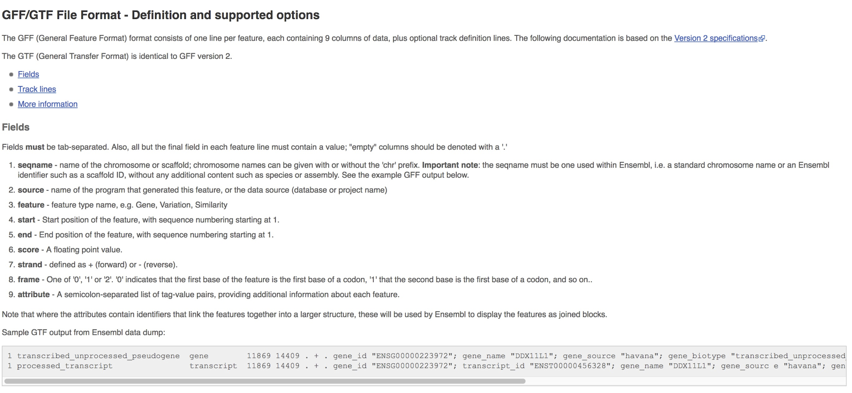
The GFF format
ARQ
http://uswest.ensembl.org/info/website/upload/gff.html

Slide 35
The grep command (this is VERY useful)
(find lines in an input file or stream that match a specific pattern you are looking for)
ARQ
$ grep "exon" genes.gtf
1 havana exon 11869 12227 . + . gene_id "ENSG00000223972"; gene_version "5"; transcript_id "ENST00000456328"; transcript_version "2"; exon_number "1"; gene_name "DDX11L1"; gene_source "havana"; gene_biotype "transcribed_unprocessed_pseudogene"; havana_gene "OTTHUMG00000000961"; havana_gene_version "2"; transcript_name "DDX11L1-002"; transcript_source "havana"; transcript_biotype "processed_transcript"; havana_transcript "OTTHUMT00000362751"; havana_transcript_version "1"; exon_id "ENSE00002234944"; exon_version "1"; tag "basic"; transcript_support_level "1";
1 havana exon 12613 12721 . + . gene_id "ENSG00000223972"; gene_version "5"; transcript_id "ENST00000456328"; transcript_version "2"; exon_number "2"; gene_name "DDX11L1"; gene_source "havana"; gene_biotype "transcribed_unprocessed_pseudogene"; havana_gene "OTTHUMG00000000961"; havana_gene_version "2"; transcript_name "DDX11L1-002"; transcript_source "havana"; transcript_biotype "processed_transcript"; havana_transcript "OTTHUMT00000362751"; havana_transcript_version "1"; exon_id "ENSE00003582793"; exon_version "1"; tag "basic"; transcript_support_level "1";
1 havana exon 13221 14409 . + . gene_id "ENSG00000223972"; gene_version "5"; transcript_id "ENST00000456328"; transcript_version "2"; exon_number "3"; gene_name "DDX11L1"; gene_source "havana"; gene_biotype "transcribed_unprocessed_pseudogene"; havana_gene "OTTHUMG00000000961"; havana_gene_version "2"; transcript_name "DDX11L1-002"; transcript_source "havana"; transcript_biotype "processed_transcript"; havana_transcript "OTTHUMT00000362751"; havana_transcript_version "1"; exon_id "ENSE00002312635"; exon_version "1"; tag "basic"; transcript_support_level "1";
...
Result:
Only lines that contain the text "exon" anywhere in the line will be returned.

Slide 36
See grep matches with --color
ARQ
$ grep --color "exon" genes.gtf
1 havana exon 11869 12227 . + . gene_id "ENSG00000223972"; gene_version "5"; transcript_id "ENST00000456328"; transcript_version "2"; exon_number "1"; gene_name "DDX11L1"; gene_source "havana"; gene_biotype "transcribed_unprocessed_pseudogene"; havana_gene "OTTHUMG00000000961"; havana_gene_version "2"; transcript_name "DDX11L1-002"; transcript_source "havana"; transcript_biotype "processed_transcript"; havana_transcript "OTTHUMT00000362751"; havana_transcript_version "1"; exon_id "ENSE00002234944"; exon_version "1"; tag "basic"; transcript_support_level "1";
1 havana exon 12613 12721 . + . gene_id "ENSG00000223972"; gene_version "5"; transcript_id "ENST00000456328"; transcript_version "2"; exon_number "2"; gene_name "DDX11L1"; gene_source "havana"; gene_biotype "transcribed_unprocessed_pseudogene"; havana_gene "OTTHUMG00000000961"; havana_gene_version "2"; transcript_name "DDX11L1-002"; transcript_source "havana"; transcript_biotype "processed_transcript"; havana_transcript "OTTHUMT00000362751"; havana_transcript_version "1"; exon_id "ENSE00003582793"; exon_version "1"; tag "basic"; transcript_support_level "1";
1 havana exon 13221 14409 . + . gene_id "ENSG00000223972"; gene_version "5"; transcript_id "ENST00000456328"; transcript_version "2"; exon_number "3"; gene_name "DDX11L1"; gene_source "havana"; gene_biotype "transcribed_unprocessed_pseudogene"; havana_gene "OTTHUMG00000000961"; havana_gene_version "2"; transcript_name "DDX11L1-002"; transcript_source "havana"; transcript_biotype "processed_transcript"; havana_transcript "OTTHUMT00000362751"; havana_transcript_version "1"; exon_id "ENSE00002312635"; exon_version "1"; tag "basic"; transcript_support_level "1";
...
Tips:
Use the right and left arrows to move towards the end and beginning of a line, respectively.

Slide 37
See grep matches with --color
ARQ
$ grep --color "gene" genes.gtf
#!genebuild-last-updated 2016-06
1 havana gene 11869 14409 . + . gene_id "ENSG00000223972"; gene_version "5"; gene_name "DDX11L1"; gene_source "havana"; gene_biotype "transcribed_unprocessed_pseudogene"; havana_gene "OTTHUMG00000000961"; havana_gene_version "2";
1 havana transcript 11869 14409 . + . gene_id "ENSG00000223972"; gene_version "5"; transcript_id "ENST00000456328"; transcript_version "2"; gene_name "DDX11L1"; gene_source "havana"; gene_biotype "transcribed_unprocessed_pseudogene"; havana_gene "OTTHUMG00000000961"; havana_gene_version "2"; transcript_name "DDX11L1-002"; transcript_source "havana"; transcript_biotype "processed_transcript"; havana_transcript "OTTHUMT00000362751"; havana_transcript_version "1"; tag "basic"; transcript_support_level "1";
1 havana exon 11869 12227 . + . gene_id "ENSG00000223972"; gene_version "5"; transcript_id "ENST00000456328"; transcript_version "2"; exon_number "1"; gene_name "DDX11L1"; gene_source "havana"; gene_biotype "transcribed_unprocessed_pseudogene"; havana_gene "OTTHUMG00000000961"; havana_gene_version "2"; transcript_name "DDX11L1-002"; transcript_source "havana"; transcript_biotype "processed_transcript"; havana_transcript "OTTHUMT00000362751"; havana_transcript_version "1"; exon_id "ENSE00002234944"; exon_version "1"; tag "basic"; transcript_support_level "1";
1 havana exon 12613 12721 . + . gene_id "ENSG00000223972"; gene_version "5"; transcript_id "ENST00000456328"; transcript_version "2"; exon_number "2"; gene_name "DDX11L1"; gene_source "havana"; gene_biotype "transcribed_unprocessed_pseudogene"; havana_gene "OTTHUMG00000000961"; havana_gene_version "2"; transcript_name "DDX11L1-002"; transcript_source "havana"; transcript_biotype "processed_transcript"; havana_transcript "OTTHUMT00000362751"; havana_transcript_version "1"; exon_id "ENSE00003582793"; exon_version "1"; tag "basic"; transcript_support_level "1";
By default, grep reports a pattern match anywhere it find it on the line.
What if we want to match "gene" but not things like "gene_name"?

Slide 38
Matches flanked by "whitespace" with -w
ARQ
$ grep --color "gene" -w genes.gtf
1 havana gene 11869 14409 . + . gene_id "ENSG00000223972"; gene_version "5"; gene_name "DDX11L1"; gene_source "havana"; gene_biotype "transcribed_unprocessed_pseudogene"; havana_gene "OTTHUMG00000000961"; havana_gene_version "2";
1 havana gene 14404 29570 . - . gene_id "ENSG00000227232"; gene_version "5"; gene_name "WASH7P"; gene_source "havana"; gene_biotype "unprocessed_pseudogene"; havana_gene "OTTHUMG00000000958"; havana_gene_version "1";
1 mirbase gene 17369 17436 . - . gene_id "ENSG00000278267"; gene_version "1"; gene_name "MIR6859-1"; gene_source "mirbase"; gene_biotype "miRNA";
1 ensembl_havana gene 29554 31109 . + . gene_id "ENSG00000243485"; gene_version "4"; gene_name "MIR1302-2"; gene_source "ensembl_havana"; gene_biotype "lincRNA"; havana_gene "OTTHUMG00000000959"; havana_gene_version "2";
1 havana gene 34554 36081 . - . gene_id "ENSG00000237613"; gene_version "2"; gene_name "FAM138A"; gene_source "havana"; gene_biotype "lincRNA"; havana_gene "OTTHUMG00000000960"; havana_gene_version "1";
1 havana gene 52473 53312 . + . gene_id "ENSG00000268020"; gene_version "3"; gene_name "OR4G4P"; gene_source "havana"; gene_biotype "unprocessed_pseudogene"; havana_gene "OTTHUMG00000185779"; havana_gene_version "1";
1 havana gene 62948 63887 . + . gene_id "ENSG00000240361"; gene_version "1"; gene_name "OR4G11P"; gene_source "havana"; gene_biotype "unprocessed_pseudogene"; havana_gene "OTTHUMG00000001095"; havana_gene_version "2";
1 ensembl_havana gene 69091 70008 . + . gene_id "ENSG00000186092"; gene_version "4"; gene_name "OR4F5"; gene_source "ensembl_havana"; gene_biotype "protein_coding"; havana_gene "OTTHUMG00000001094"; havana_gene_version "2";
By default, grep reports a pattern match anywhere it find it on the line.
What if we want to match "gene" but not things like "gene_name"?

Slide 39
Report lines that lack a pattern with -v
ARQ
$ grep "gene" -v genes.gtf
#!genome-build GRCh38.p7
#!genome-version GRCh38
#!genome-date 2013-12
#!genome-build-accession NCBI:GCA_000001405.22
Why are these the only lines that are reported?

Slide 40
Report lines that lack a pattern with -v and -w
ARQ
$ grep "gene" -v -w genes.gtf
#!genome-build GRCh38.p7
#!genome-version GRCh38
#!genome-date 2013-12
#!genome-build-accession NCBI:GCA_000001405.22
#!genebuild-last-updated 2016-06
1 havana transcript 11869 14409 . + . gene_id "ENSG00000223972"; gene_version "5"; transcript_id "ENST00000456328"; transcript_version "2"; gene_name "DDX11L1"; gene_source "havana"; gene_biotype "transcribed_unprocessed_pseudogene"; havana_gene "OTTHUMG00000000961"; havana_gene_version "2"; transcript_name "DDX11L1-002"; transcript_source "havana"; transcript_biotype "processed_transcript"; havana_transcript "OTTHUMT00000362751"; havana_transcript_version "1"; tag "basic"; transcript_support_level "1";
1 havana exon 11869 12227 . + . gene_id "ENSG00000223972"; gene_version "5"; transcript_id "ENST00000456328"; transcript_version "2"; exon_number "1"; gene_name "DDX11L1"; gene_source "havana"; gene_biotype "transcribed_unprocessed_pseudogene"; havana_gene "OTTHUMG00000000961"; havana_gene_version "2"; transcript_name "DDX11L1-002"; transcript_source "havana"; transcript_biotype "processed_transcript"; havana_transcript "OTTHUMT00000362751"; havana_transcript_version "1"; exon_id "ENSE00002234944"; exon_version "1"; tag "basic"; transcript_support_level "1";
...

Slide 41
Matching patterns that include quotes
ARQ
$ grep --color "CDC53" genes.gtf
What if we want to find lines with a specific gene name (note that the GFF has gene names in quotes). We need to tell grep to treat quote characters literally!
1 ensembl_havana gene 113813811 113871759 . - . gene_id "ENSG00000134242"; gene_version "15"; gene_name "PTPN22"; gene_source "ensembl_havana"; gene_biotype "protein_coding"; havana_gene "OTTHUMG00000011936"; havana_gene_version "2";
1 havana transcript 113813811 113871712 . - . gene_id "ENSG00000134242"; gene_version "15"; transcript_id "ENST00000460620"; transcript_version "5"; gene_name "PTPN22"; gene_source "ensembl_havana"; gene_biotype "protein_coding"; havana_gene "OTTHUMG00000011936"; havana_gene_version "2"; transcript_name "PTPN22-002"; transcript_source "havana"; transcript_biotype "protein_coding"; havana_transcript "OTTHUMT00000033016"; havana_transcript_version "2"; tag "basic"; transcript_support_level "1";
1 havana exon 113871537 113871712 . - . gene_id "ENSG00000134242"; gene_version "15"; transcript_id "ENST00000460620"; transcript_version "5"; exon_number "1"; gene_name "PTPN22"; gene_source "ensembl_havana"; gene_biotype "protein_coding"; havana_gene "OTTHUMG00000011936"; havana_gene_version "2"; transcript_name "PTPN22-002"; transcript_source "havana"; transcript_biotype "protein_coding"; havana_transcript "OTTHUMT00000033016"; havana_transcript_version "2"; exon_id "ENSE00001835701"; exon_version "1"; tag "basic"; transcript_support_level "1";
1 havana CDS 113871537 113871623 . - 0 gene_id "ENSG00000134242"; gene_version "15"; transcript_id "ENST00000460620"; transcript_version "5"; exon_number "1"; gene_name "PTPN22"; gene_source "ensembl_havana"; gene_biotype "protein_coding"; havana_gene "OTTHUMG00000011936"; havana_gene_version "2"; transcript_name "PTPN22-002"; transcript_source "havana"; transcript_biotype "protein_coding"; havana_transcript "OTTHUMT00000033016"; havana_transcript_version "2"; protein_id "ENSP00000433141"; protein_version "1"; tag "basic"; transcript_support_level "1";

Slide 42
Matching patterns that include quotes
ARQ
$ grep --color \"CDC53\" genes.gtf
What if we want to find lines with a specific gene name (note that the GFF has gene names in quotes). We need to tell grep to treat quote characters literally!
To do so, we must "escape" them.
Note this match from our last attempt disappeared. Why?
1 ensembl_havana gene 113813811 113871759 . - . gene_id "ENSG00000134242"; gene_version "15"; gene_name "PTPN22"; gene_source "ensembl_havana"; gene_biotype "protein_coding"; havana_gene "OTTHUMG00000011936"; havana_gene_version "2";
1 havana transcript 113813811 113871712 . - . gene_id "ENSG00000134242"; gene_version "15"; transcript_id "ENST00000460620"; transcript_version "5"; gene_name "PTPN22"; gene_source "ensembl_havana"; gene_biotype "protein_coding"; havana_gene "OTTHUMG00000011936"; havana_gene_version "2"; transcript_name "PTPN22-002"; transcript_source "havana"; transcript_biotype "protein_coding"; havana_transcript "OTTHUMT00000033016"; havana_transcript_version "2"; tag "basic"; transcript_support_level "1";
1 havana exon 113871537 113871712 . - . gene_id "ENSG00000134242"; gene_version "15"; transcript_id "ENST00000460620"; transcript_version "5"; exon_number "1"; gene_name "PTPN22"; gene_source "ensembl_havana"; gene_biotype "protein_coding"; havana_gene "OTTHUMG00000011936"; havana_gene_version "2"; transcript_name "PTPN22-002"; transcript_source "havana"; transcript_biotype "protein_coding"; havana_transcript "OTTHUMT00000033016"; havana_transcript_version "2"; exon_id "ENSE00001835701"; exon_version "1"; tag "basic"; transcript_support_level "1";
1 havana CDS 113871537 113871623 . - 0 gene_id "ENSG00000134242"; gene_version "15"; transcript_id "ENST00000460620"; transcript_version "5"; exon_number "1"; gene_name "PTPN22"; gene_source "ensembl_havana"; gene_biotype "protein_coding"; havana_gene "OTTHUMG00000011936"; havana_gene_version "2"; transcript_name "PTPN22-002"; transcript_source "havana"; transcript_biotype "protein_coding"; havana_transcript "OTTHUMT00000033016"; havana_transcript_version "2"; protein_id "ENSP00000433141"; protein_version "1"; tag "basic"; transcript_support_level "1";

Slide 43

Piping Unix commands together with "|"
The sum is greater than its parts.
ARQ
# find the first 10 "gene" matches
$ grep "gene" genes.gtf | head
# how many total "gene" matches?
$ grep "gene" genes.gtf | wc -l
# alphabetically sort the "gene" match lines and report the first 10 in alphabetical order
$ grep "gene" genes.gtf | sort | head | less -S
Notes:
Jump to 1:09

Slide 44
Piping Unix commands together with "|"
The sum is greater than its parts.
ARQ
# alphabetically sort the "gene" match lines and report the first 10 in alphabetical order
$ grep "gene" genes.gtf | sort | head
command 1
command 2
command 3
"stdout"
Notes:
Jump to 1:09

Slide 45
How many lines contain CDC53?
ARQ
$ grep --color \”CDC53\" genes.gtf | wc -l

Slide 46
How many exon records are there for CDC53?
ARQ
$ grep --color \"CDC53\" genes.gtf | grep -w exon | wc -l

Slide 47
ARQ
The ability to pipe together many simple tools to create something quite complex is one of UNIX's key strengths.
Notes:
Jump to 1:09

Slide 48
The cut command
(cut out specific columns/fields from a file or input stream)
ARQ
So far, we have been working with entire lines of files. Many times we want to just explore specific subsets of information in a file. The grep command helps to isolate specific lines. The cut command helps us to extract specific columns from lines.
The cut command assumes that your file or input stream (in the case of a pipe) is tab-delimited.

Slide 49
The cut command
(cut out specific columns/fields from a file or input stream)
ARQ
$ less -S genes.gtf
#!genome-build GRCh38.p7
#!genome-version GRCh38
#!genome-date 2013-12
#!genome-build-accession NCBI:GCA_000001405.22
#!genebuild-last-updated 2016-06
1 havana gene 11869 14409 . + . gene_id "ENSG00000223972"; gene_version "5"; gene_name "DDX11L1"; gene_source "havana";
1 havana transcript 11869 14409 . + . gene_id "ENSG00000223972"; gene_version "5"; transcript_id "ENST00000456328"; tr
1 havana exon 11869 12227 . + . gene_id "ENSG00000223972"; gene_version "5"; transcript_id "ENST00000456328"; transcript
1 havana exon 12613 12721 . + . gene_id "ENSG00000223972"; gene_version "5"; transcript_id "ENST00000456328"; transcript
1 havana exon 13221 14409 . + . gene_id "ENSG00000223972"; gene_version "5"; transcript_id "ENST00000456328"; transcript
1 havana transcript 12010 13670 . + . gene_id "ENSG00000223972"; gene_version "5"; transcript_id "ENST00000450305"; tr
1 havana exon 12010 12057 . + . gene_id "ENSG00000223972"; gene_version "5"; transcript_id "ENST00000450305"; transcript
1 havana exon 12179 12227 . + . gene_id "ENSG00000223972"; gene_version "5"; transcript_id "ENST00000450305"; transcript
1 havana exon 12613 12697 . + . gene_id "ENSG00000223972"; gene_version "5"; transcript_id "ENST00000450305"; transcript
1 havana exon 12975 13052 . + . gene_id "ENSG00000223972"; gene_version "5"; transcript_id "ENST00000450305"; transcript
1 havana exon 13221 13374 . + . gene_id "ENSG00000223972"; gene_version "5"; transcript_id "ENST00000450305"; transcript
1 havana exon 13453 13670 . + . gene_id "ENSG00000223972"; gene_version "5"; transcript_id "ENST00000450305"; transcript
1 havana gene 14404 29570 . - . gene_id "ENSG00000227232"; gene_version "5"; gene_name "WASH7P"; gene_source "havana"; g
1 havana transcript 14404 29570 . - . gene_id "ENSG00000227232"; gene_version "5"; transcript_id "ENST00000488147"; tr
1 havana exon 29534 29570 . - . gene_id "ENSG00000227232"; gene_version "5"; transcript_id "ENST00000488147"; transcript
1 havana exon 24738 24891 . - . gene_id "ENSG00000227232"; gene_version "5"; transcript_id "ENST00000488147"; transcript
1 havana exon 18268 18366 . - . gene_id "ENSG00000227232"; gene_version "5"; transcript_id "ENST00000488147"; transcript
1 havana exon 17915 18061 . - . gene_id "ENSG00000227232"; gene_version "5"; transcript_id "ENST00000488147"; transcript
1 havana exon 17606 17742 . - . gene_id "ENSG00000227232"; gene_version "5"; transcript_id "ENST00000488147"; transcript
Invisible tab (\t) characters

Slide 50
The cut command identifies columns by number
ARQ
$ less -S genes.gtf
The long strings of text at the end of each line are treated as a single column. Why?
Because the text within is separated by spaces, not tabs.
#!genome-build GRCh38.p7
#!genome-version GRCh38
#!genome-date 2013-12
#!genome-build-accession NCBI:GCA_000001405.22
#!genebuild-last-updated 2016-06
1 havana gene 11869 14409 . + . gene_id "ENSG00000223972"; gene_version "5"; gene_name "DDX11L1"; gene_source "havana";
1 havana transcript 11869 14409 . + . gene_id "ENSG00000223972"; gene_version "5"; transcript_id "ENST00000456328"; tr
1 havana exon 11869 12227 . + . gene_id "ENSG00000223972"; gene_version "5"; transcript_id "ENST00000456328"; transcript
1 havana exon 12613 12721 . + . gene_id "ENSG00000223972"; gene_version "5"; transcript_id "ENST00000456328"; transcript
1 havana exon 13221 14409 . + . gene_id "ENSG00000223972"; gene_version "5"; transcript_id "ENST00000456328"; transcript
1 havana transcript 12010 13670 . + . gene_id "ENSG00000223972"; gene_version "5"; transcript_id "ENST00000450305"; tr
1 havana exon 12010 12057 . + . gene_id "ENSG00000223972"; gene_version "5"; transcript_id "ENST00000450305"; transcript
1 havana exon 12179 12227 . + . gene_id "ENSG00000223972"; gene_version "5"; transcript_id "ENST00000450305"; transcript
1 havana exon 12613 12697 . + . gene_id "ENSG00000223972"; gene_version "5"; transcript_id "ENST00000450305"; transcript
1 havana exon 12975 13052 . + . gene_id "ENSG00000223972"; gene_version "5"; transcript_id "ENST00000450305"; transcript
1 havana exon 13221 13374 . + . gene_id "ENSG00000223972"; gene_version "5"; transcript_id "ENST00000450305"; transcript
1 havana exon 13453 13670 . + . gene_id "ENSG00000223972"; gene_version "5"; transcript_id "ENST00000450305"; transcript
1 havana gene 14404 29570 . - . gene_id "ENSG00000227232"; gene_version "5"; gene_name "WASH7P"; gene_source "havana"; g
1 havana transcript 14404 29570 . - . gene_id "ENSG00000227232"; gene_version "5"; transcript_id "ENST00000488147"; tr
1 havana exon 29534 29570 . - . gene_id "ENSG00000227232"; gene_version "5"; transcript_id "ENST00000488147"; transcript
1 havana exon 24738 24891 . - . gene_id "ENSG00000227232"; gene_version "5"; transcript_id "ENST00000488147"; transcript
1 havana exon 18268 18366 . - . gene_id "ENSG00000227232"; gene_version "5"; transcript_id "ENST00000488147"; transcript
1 havana exon 17915 18061 . - . gene_id "ENSG00000227232"; gene_version "5"; transcript_id "ENST00000488147"; transcript
1 havana exon 17606 17742 . - . gene_id "ENSG00000227232"; gene_version "5"; transcript_id "ENST00000488147"; transcript
1
2
3
4
5
6
7
8
9

Slide 51
Use cut to extract solely the second column
ARQ
$ cut -f 2 genes.gtf | head –n 20
#!genome-build R64-1-1
#!genome-version R64-1-1
#!genome-date 2011-09
#!genome-build-accession GCA_000146045.2
#!genebuild-last-updated 2018-10
sgd
sgd
sgd
sgd
sgd
sgd
sgd
sgd
sgd
sgd
sgd
sgd
sgd
sgd
sgd
Why were the first 5 lines reported?
How could we prevent that?

Slide 52
Let's omit the header lines first.
ARQ
$ grep -v "#!gen" genes.gtf | cut -f 2 | head -n 20
sgd
sgd
sgd
sgd
sgd
sgd
sgd
sgd
sgd
sgd
sgd
sgd
sgd
sgd
sgd
sgd
sgd
sgd
sgd
sgd
The more specific the command, the better (maybe another line later has a “#” included that we wouldn’t want to miss

Slide 53
Saving results to files with >
ARQ
So far, every command we have run reports the output to the screen (i.e., standard output or "stdout").
Obviously, once an analysis is working the way we want, we typically wish to save the results to a file.
We do this with the "redirect to a file operator": >

Slide 54
Saving results to files with >
ARQ
$ grep -v "#" genes.gtf | cut -f 2 | head -n 20 > column2.first20.txt
$ cat column2.first20.txt
sgd
sgd
sgd
sgd
sgd
sgd
sgd
sgd
sgd
sgd
sgd
sgd
sgd
sgd
sgd
sgd
sgd
sgd
sgd
sgd

Slide 55
The results are just a plain old file!
ARQ
$ head -n 2 column2.first20.txt
sgd
sgd

Slide 56
Homework
Submit CHPC application
https://www.chpc.utah.edu/documentation/gettingstarted.php

